Slide 1
Engineering Design Process
November 19, 2016
Olga Cammer
5th Grade Teacher
Sierra Vista Elementary
La Habra City School District

Slide 2
The 4 C’s: Super Skills for the 21st Century
Collaboration
Working together to reach a goal
Putting talent, expertise, and smarts to work
Communication
Sharing thoughts, questions, ideas, and solutions
Critical Thinking
Looking at problems in a new way,
Linking learning across subjects and disciplines
Creativity
Trying new approaches to get things done equals innovation and invention

Slide 3
21st Century Learning
Above and Beyond
Peter Reynolds
P21
Fablevision

What are some 21st Century Skills shown in the video?

Slide 4
STEM
Science
Hands-on and Inquiry based
Technology
The products and systems that meet human needs
Engineering
Design and create
Mathematics
What mathematics are included in science and engineering?

Slide 5
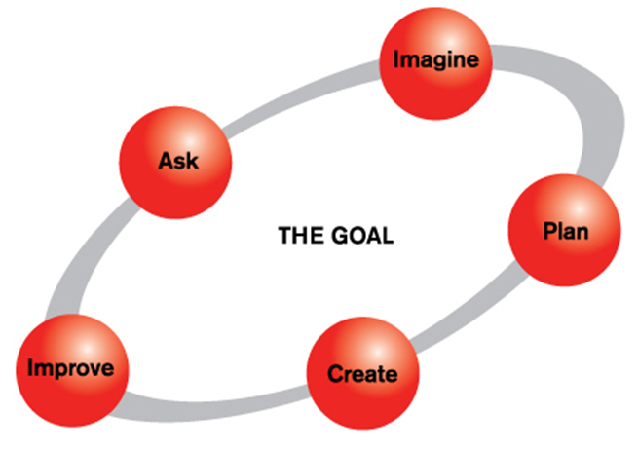
Engineering Design Process

Slide 6
Engineering Design Process
Ask
What do you want to know?
What are the constraints?
Imagine
Brainstorm ideas
What are some solutions?
Plan
Draw a diagram
Make a list of materials you will need.
Create
Follow your plan and create it.
Test it out?
Improve
Make your design better.
Test it out.

Slide 7
Engineering Design Challenge
Challenge: Build a tower that will support a stuffed bear.
Materials: 50 3x5” index cards
Constraint: The bear must be displayed at least 10 cm off of the table.
Constraint: Time

